Slide 1

Please note
There is no lecture on Monday 5th March since I am away at a conference
I will be away from the laboratory sessions on:
Thursday 1th March
Monday 5th March
Thursday 8th March
The lab sessions will still run and Jake will be available for assistance
I have already uploaded the first part of the assessed coursework

Slide 2
ROCO218: Control Engineering Dr Ian Howard Lecture 5 Coursework assessments

Slide 3
Coursework assessment
There will be practical assessments in the form of laboratory practical work
40% ROCO218
50% ROCO223
Your complete lab report must be submitted via the DLE by
Thursday 4pm, 17th May 2018
There will also be a final exam for the course
60% ROCO218
50% ROCO223
The total mark for this coursework will be the sum of the marks for each individual report with each report contributing to the total coursework mark. The mark for each report will be awarded as indicated in the coursework sheet

Slide 4
Important note on assessed coursework practical
You are required to write a short report on each of the assessed coursework. This should describe:
The task or problems you were asked to solve.
An explanation of your solution.
Your results and findings.
Your insights and conclusions.
You need to work in pairs for the practical sessions but submit a report INDIVIDUALLY!
Please also look at: StudentxxxROCO218223ReportTemplate.doc
Report requirements:
The report must only be a single PDF document of several hundred words per practical, although this is just a rough suggestion.
You are strongly encouraged to include photos, diagrams, plots and even linked videos to support your work.
Embed any code in-line the report (do not use appendices)
There is a 150MB limit on the final submission (but your PDF should be much less than this).
Please check that your submitted files are correct by downloading them again and checking that the content is correct

Slide 5
Report format
Please only submit your overall report as a PDF.
When you write your report, you must include you student number on every page of the report in a header and also include it in the document filename!
Each laboratory report should contain a few pages of written explanation (although it can be more than this) as well as a set of images and diagrams to explain your solutions to the practical exercises.
Embed any code in-line the report (do not use appendices)
Please also include embedded links to short video to illustrate operation of your project if you use videos
Please also look at:
StudentxxxROCO218223ReportTemplate

Slide 6
ROCO218: Control Engineering Dr Ian Howard Lecture 5 Introduction to state space models

Slide 7
PID verses state space methods
PID control can be very successful
But assumes one input signal and one output signal!
Transfer functions only represent input and out relationships
Do not handle systems that have several inputs and outputs (MIMO) well
Especially if there is strong cross coupling within the system!
Typically, tuning such systems using intuition and experience results in no more than mediocre performance
We need rigorous mathematical methods!
A state space model is a description of system dynamics using state variables.
Formulated using matrix notation
Supports multivariable systems and control (MIMO)
Works with time varying systems
Works with non-linear systems (after linearization)
Under certain conditions, “variables inside the system” (states) can be:
Controlled without actuators
Observed without sensors
State space approach handles optimality and robustness

Slide 8
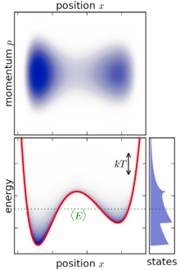
State space variables
The state of a dynamic system often directly describes the distribution of internal energy in the system
i.e. internal energy can always be computed from the state variable).
For example, it is common to select the following as state variables:
Position (potential energy)
Velocity (kinetic energy)
Capacitor voltage (electric energy)
Inductor current (magnetic energy)
The state provides us with important internal information
• Analysis then makes use of the concepts of
- Stability
- Controllability
- Observability
Addresses realization issues of:
Design
Linear Quadratic Regulator
Kalman Filter
State feedback
Using Observers

Slide 9
State space system representation
A state space representation describes a system as a set of 1st order ODEs
We want to describe the system dynamics with a matrix equation of the form
Where
Is the time derivative of the state vector
Is the system matrix
Is the state vector
Is the control input matrix
Is the control input

Slide 10
State space output representation
Similarly we want to describe the output with a matrix equation of the form
Where
Is the output
Is the output or observation matrix
Is the state vector
Is the transmission matrix
Is the control input

Slide 11
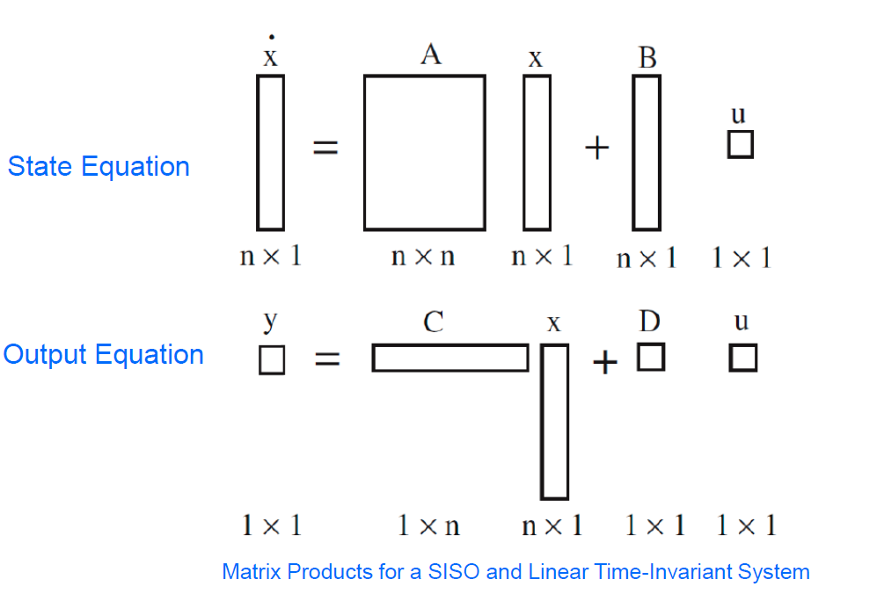
State space SISO representation summary

Slide 12
State space representation
We need to write a high order ODE as set of 1st order ODEs
For example we can rewrite a second-order differential equation as a set of two first-order differential equation.
Consider the following general second-order differential equation:
Where the dot denotes differentiation w.r.t. time
We can then define y as
Differentiation of y w.r.t. time, we obtain:
Therefore, we end up with a system of two first-order differential equations:

Slide 13
State space representation
Similarly, if we consider a general third-order differential equation of the form:
Then we can define
Which after time differentiation gives:
Therefore, we end up with a system of three first-order differential equations:
The same strategy works with an nth-order differential equation that can be transformed into a set of n first-order differential equation.

Slide 14
ROCO218: Control Engineering Dr Ian Howard Lecture 5 Mapping 2nd order ODE to state space

Slide 15
2nd order ODE to state space: Easy case
Consider the differential equation
Re-writing with highest derivative on the LHS we have
This is a 2nd order equation!
Therefore highest derivative state variable must be less than 2nd order – i.e. 1st order
Choosing the state variables
First state equation

Slide 16
2nd order ODE to state space: Easy case
Substituting
Remember
into
Second state equation
Therefore we have the state equations
Writing state space form
and
This leads to the dynamics equation
And the output equation

Slide 17
2nd order ODE to state space: Harder case
Consider the differential equation
We now have as differential term on the RHS
We need to choose state variable so this is cancelled out!
Re-writing with highest derivative on the LHS
If we choose the state variables as before
Substituting
into
We will still have as differential term on the RHS We don’t want this!
We are not allowed differential terms on the RHS of the matrix equations

Slide 18
2nd order ODE to state space: Harder case
So starting with the re-written equation
Now adding same term to both sides
We now choose the state variables
Substituting
Into
The differential u term is now cancelled out!

Slide 19
2nd order ODE to state space: Harder case
Since
and
Output equation
So the equation
Second state equation
Again since
First state equation

Slide 20
2nd order ODE to state space: Harder case
Thus this time we have the state equations
This leads to the dynamics equation
And the output equation

Slide 21
ROCO218: Control Engineering Dr Ian Howard Lecture 5 Eigenvalues and Eigenvectors

Slide 22
Eigenvalue problems
Consider simultaneous equations of the form:
where A is an n x n matrix, x is an n x 1 column vector and λ is a scalar constant
The solution to the equation is a vector X
When we transform X by multiplying by A we end up with vector X again but this times scaled by λ
Therefore the direction of vector X is unaffected by the transformation

Slide 23
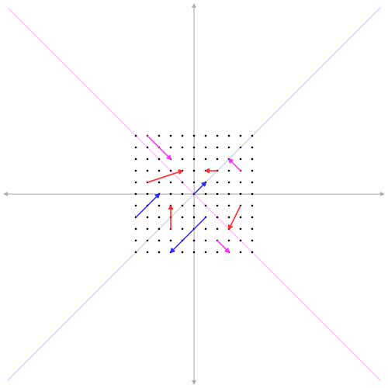
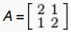
Example eigenvector from Wikipedia
Transformation matrix only preserves the direction of the blue and purple vectors that are parallel to the diagonals
These are the eigenvectors
It does not preserve the direction of the red vectors

Slide 24
Finding eigenvalues and eigenvectors
Given the matrix A. e.g. where
We will now find its eigenvalues λ and eigenvectors
We must solve the equation
There is a trivial solution if the matrix (A-λ) has an inverse since
We want the non-trivial solution!
If there is no inverse then det(A-λ)=0
Also written as

Slide 25
Finding eigenvalues and eigenvectors
Evaluating
Remember
This is the characteristic equation of the A matrix
The characteristic equation has solutions that indicates the eigenvalues of the system

Slide 26
Finding eigenvalues and eigenvectors
When
Giving
So eigenvectors are proportional to this X vector: e.g.
Can
normalize

Slide 27
Finding eigenvalues and eigenvectors
When
Giving
Normalized already
So eigenvectors are proportional to this X vector: e.g.

Slide 28
The two solutions
So the the matrix A
Has the two eigenvalues λ given by
And the two associated eigenvectors

Slide 29
ROCO218: Control Engineering Dr Ian Howard Lecture 5 Transfer function of a state space model

Slide 30
Mapping state space models to transfer functions
From state space equations with system dynamics
And output relations
Taking Laplace transformation of system equation assuming zero initial conditions
Collecting the X(s) terms on the LHS
NB: need sI here since this is matrix algebra and I is the identity matrix
Multiplying both sides by inverse of (sI-A)

Slide 31
Mapping state space models to transfer functions
Taking Laplace transformation of output equation assuming zero initial conditions
Substituting in expression for X(s):
Collecting the U(s) terms on the RHS
This leads to an expression for the transfer function G(s)

Slide 32
Mapping state space models to transfer functions
The expression for the transfer function G(s)
Expanding the inverse matrix term
We see that the transfer function has “poles” and goes to infinity when the denominator term is zero, that is when
Therefore:
The poles of the transfer function correspond to the eigenvalues of the matrix (sI-A)

Slide 33
Example state space model to transfer functions
Given the state space system
Transfer function is given by
Where
There is no D term and

Slide 34
Example state space model to transfer functions
And
This starts to get tricky to evaluate by hand
So lets use Matlab!

Slide 35
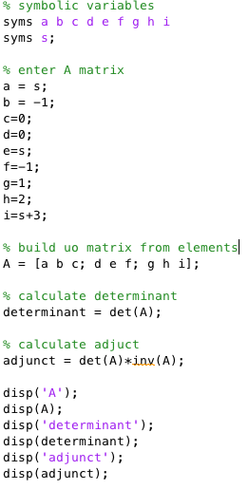
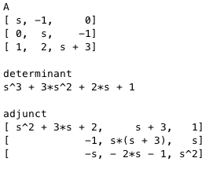
Example state space model to transfer functions
Solve using Matlab symbolic processing

Slide 36
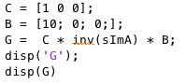
Example state space model to transfer functions
Since transfer function is given by
Solve using Matlab symbolic processing
(10*(s^2 + 3*s + 2))/(s^3 + 3*s^2 + 2*s + 1)

Slide 37
Eigenvalues and stability
For the system
The stability of the equilibrium is examined by calculating the eigenvalues λ of the system matrix A.
In particular this is achieved by solving the expression
The eigenvalues of the system relate to its poles and will determine if the equilibriums are stable or not
In a 2-dimensional systems, the eigenvalues will have the general form: = a ± ib (i.e. complex numbers).

Slide 38
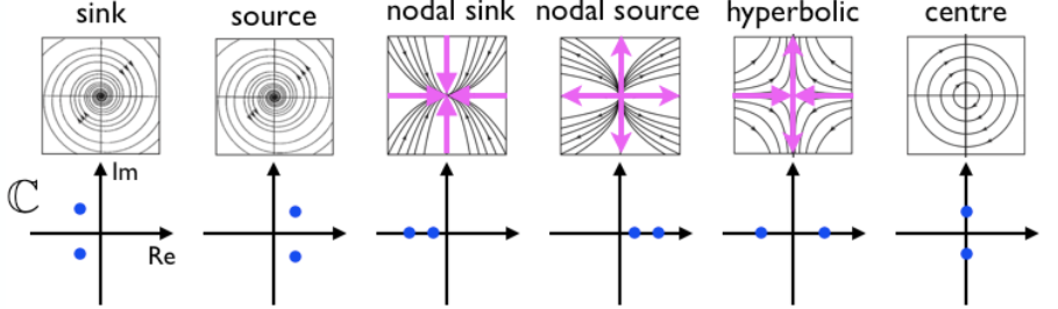
Eigenvalues and stability
If eigenvalues has a negative real part, the system will have a component that is stable
If eigenvalues has a positive real part, the system will have a component that is unstable
If the real part is zero, then the system is neutral - neither stable nor unstable
If the eigenvalues have a complex part there are oscillations

Slide 39
ROCO218: Control Engineering Dr Ian Howard Lecture 5 State feedback control

Slide 40
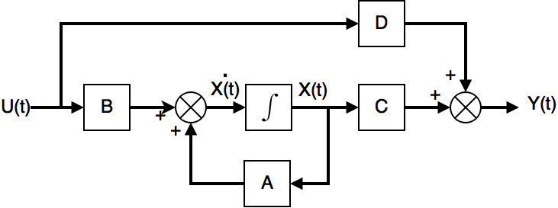
State space feedback control
State space model is described by the following equations
Where in general we have a control input on the LHS as shown below

Slide 41
Simulink simulation of a state space model

Slide 42
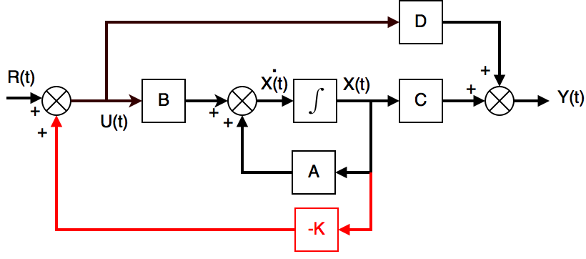
State space feedback control
To implement feedback control of this system we must use some form of feedback in the system
One option is to use state feedback
This is represented by the expression
The feedback matrix K represents feedback gain of the system state and R(t) represent a reference input
The state feedback path is depicted in red

Slide 43
State space feedback control
Substituting in
Looking at the the expression
we see than the close- loop stability now depends on eigenvalues λ given by the characteristic equation
Thus we can influence the location of the eigenvalues of the system by changing the gain matrix K

Slide 44
State space feedback control summary
In an open loop system
In a closed loop system
Stability determined by location of poles which are the eigenvalue of matrix A
Stability determined by location of poles which are the eigenvalue of matrix (A-BK)
In a state feedback system, choosing the value of K can enable designer to change the location of the poles of the system
However in general it is not necessarily trivial to determine K

Slide 45
ROCO218: Control Engineering Dr Ian Howard Lecture 6 Example: Mass spring damper SFC

Slide 46
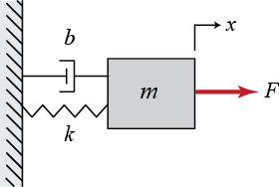
Modelling mass spring damper
Consider damped mass on a spring
Where:
m = 1Kg
k = 2 N/m
b = 3 N/ms⁻¹
Input
force
Opposition by
Inertial mass
Viscous
resistance
Spring
resistance

Slide 47
Mass spring damper state space model
From differential equation
Identify its states
The highest state must be less than highest differential eqn term
Also identify the control input

Slide 48
Mass spring damper state space model
Rewriting differential equation
So given
This gives the state equations
Therefore

Slide 49
Mass spring damper state space model
So from
In state space matrix in standard form this gives
if output y = x₁

Slide 50
Mass spring damper uncontrolled behavior
If m=1, k =2 and b=3, this leads to the numeric matrices
So system matrix
The eigenvalues λ of this open loop system are given by
Remember
This gives the characteristic equation for the system
Here Eigenvalues are –ve and real therefore the system is stable

Slide 51
Mass spring damper state feedback control
From the mass spring damper system
so
Applying state feedback control we have
where
The eigenvalues λ of this closed loop system are given by
The term

Slide 52
Mass spring damper state feedback control
Therefore
This gives the characteristic equation for the system
If say we want eigenvalues at λ =-1,-5
This gives the required characteristic equation
We see our system can achieve this if
So choosing gain appropriately we can out the eigenvalues where we want them in this case

Slide 53
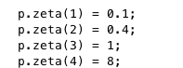
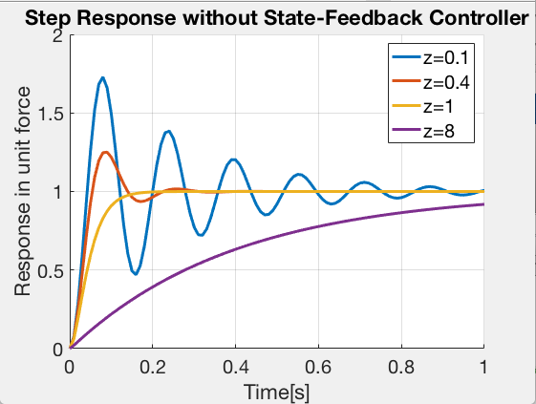
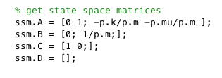
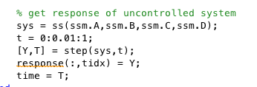
Mass spring damper Matlab step response simulation
Here we simulate the mass spring damper response to step force input for a range of damping ratio values.
We then sets appropriate values of m, k and mu to achieve these zeta values

Slide 54
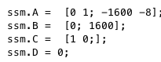
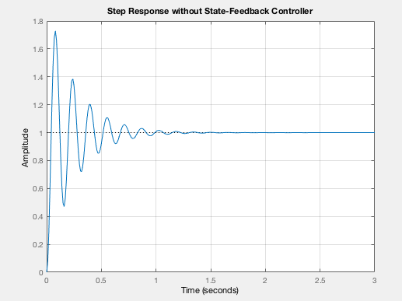
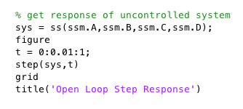
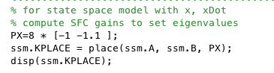
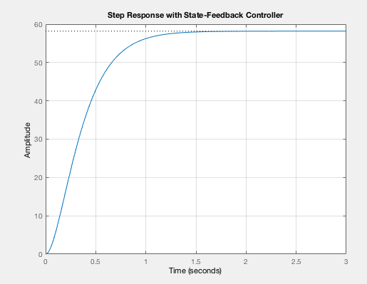
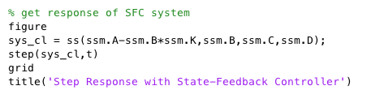
Mass spring damper uncontrolled/SFC response
Now we choose params to give an underdamped uncontrolled response

